Slide 1




Slide 2
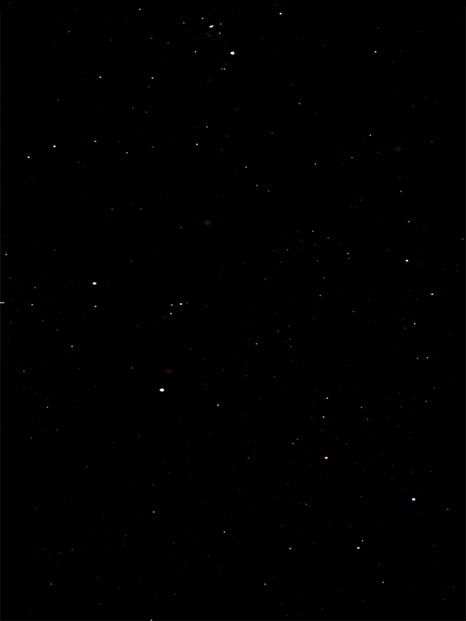
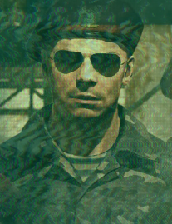
Welcome to CV Shooter.
This is a space shooter game controlled by opencv color detection. You need a red object to play this game.
On your right, there should be a webcam view with lines dividing the entire screen.
The ship can move 8 different directions based on where the red color is detected. Try moving the ship!
If you don’t have a red object, use the Arrow Keys!
You can also press Spacebar to activate a bomb that clears all enemy bullets on screen
Press Q to quit to main menu
A group of alien spaceships are trying to invade Earth.
It is up to you, the pilot of the only spaceship left on Earth to drive away those invaders. Good luck!

Slide 3
Congratulations! You have defeated the alien spaceships trying to invade Earth!

Slide 4
The last hope for humanity has been destroyed.
The aliens took over the planet.
Humanity is forced to leave their home planet and voyage into the endless darkness…

Slide 5
Challenge Finished.

Slide 6
You are overwhelmed

